Slide 1

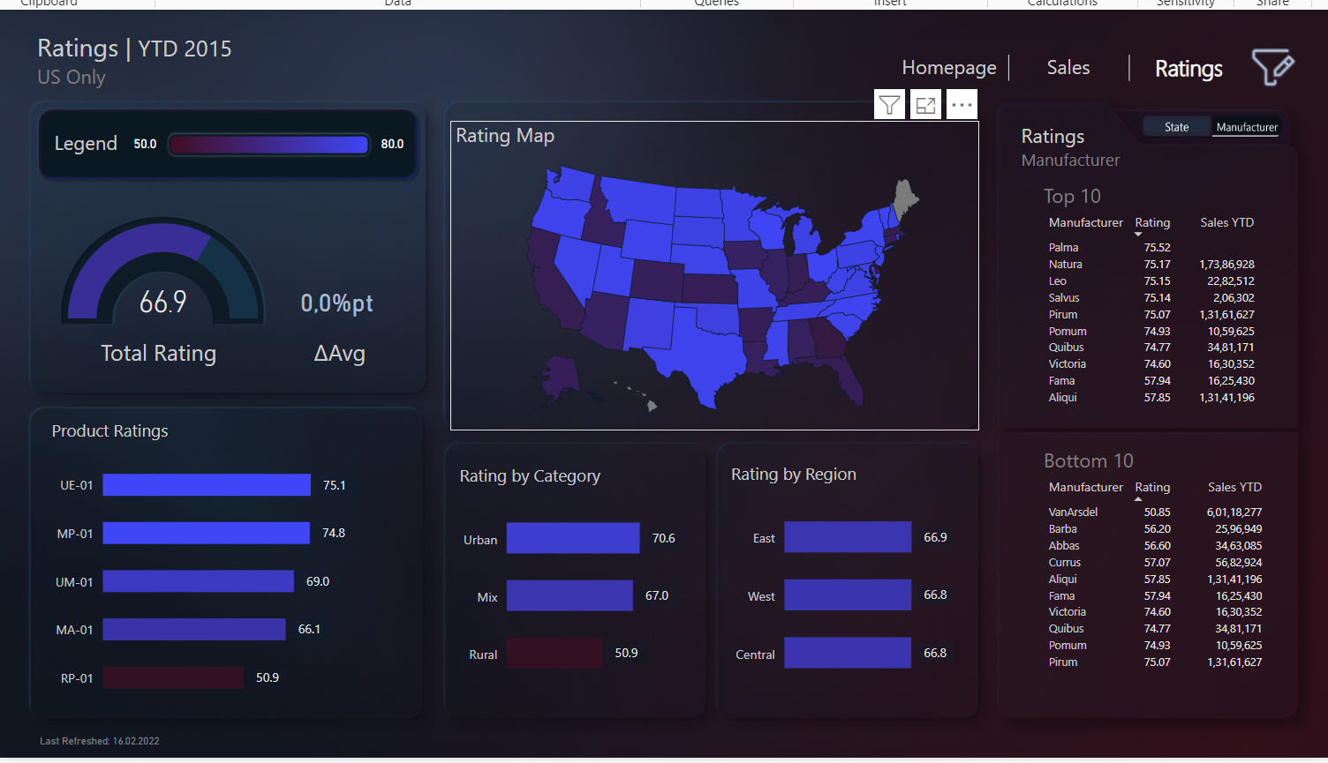
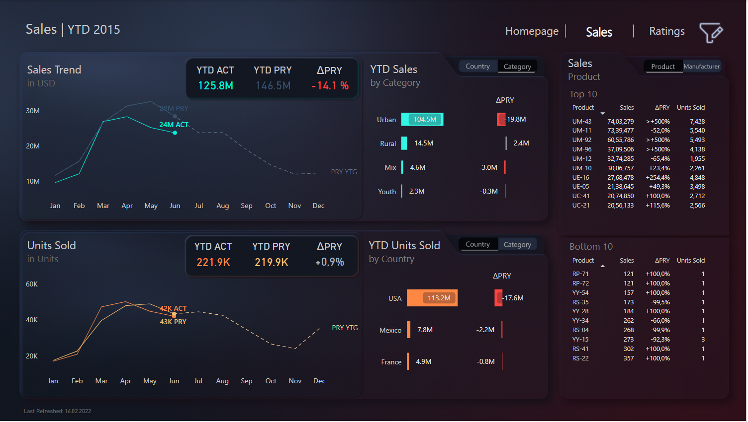


Dashboard sales Makeover
View in Power BI
Last data refresh:
5/14/2024 5:17:01 PM UTC
Downloaded at:
5/14/2024 5:17:43 PM UTC

Slide 2
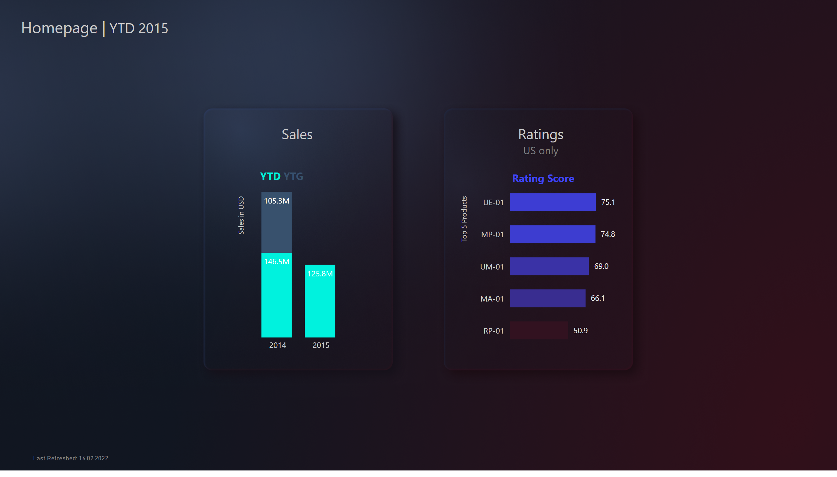
Homepage
Notes:
textbox
No alt text provided
textbox
No alt text provided
card
No alt text provided
columnChart
No alt text provided
textbox
No alt text provided
actionButton
No alt text provided
textbox
No alt text provided
Rated Products
No alt text provided
shape
No alt text provided
shape
No alt text provided
actionButton
No alt text provided
textbox
No alt text provided
textbox
No alt text provided

Slide 3
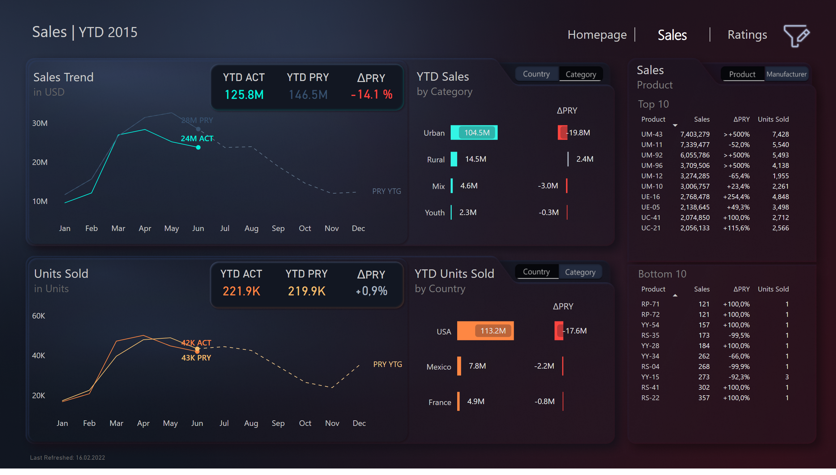
Sales
Notes:
textbox
No alt text provided
card
No alt text provided
shape
No alt text provided
actionButton
No alt text provided
textbox
No alt text provided
actionButton
No alt text provided
textbox
No alt text provided
slicer
No alt text provided
slicer
No alt text provided
slicer
No alt text provided
shape
No alt text provided
slicer
No alt text provided
slicer
No alt text provided
shape
No alt text provided
slicer
No alt text provided
YTD by Category
No alt text provided
Revenue Diff
No alt text provided
YTD by Country
No alt text provided
Revenue Diff ABS
No alt text provided
YTD vs PRY by Date
No alt text provided
textbox
No alt text provided
YTD vs PRY by Date
No alt text provided
textbox
No alt text provided
pivotTable
No alt text provided
pivotTable
No alt text provided
textbox
No alt text provided
actionButton
No alt text provided
actionButton
No alt text provided
textbox
No alt text provided
Top 10
No alt text provided
actionButton
No alt text provided
actionButton
No alt text provided
Bottom 10
No alt text provided
textbox
No alt text provided
textbox
No alt text provided
textbox
No alt text provided
textbox
No alt text provided
actionButton
No alt text provided
actionButton
No alt text provided
actionButton
No alt text provided
actionButton
No alt text provided
YTD ACT
No alt text provided
ΔPRY
No alt text provided
YTD PRY
No alt text provided
YTD ACT
No alt text provided
ΔPRY
No alt text provided
YTD PRY
No alt text provided
textbox
No alt text provided
actionButton
No alt text provided
actionButton
No alt text provided
actionButton
No alt text provided
shape
No alt text provided
shape
No alt text provided
Button default
No alt text provided
actionButton
No alt text provided
slicer
No alt text provided
slicer
No alt text provided
slicer
No alt text provided
image
No alt text provided
textbox
No alt text provided
textbox
No alt text provided
actionButton
No alt text provided
actionButton
No alt text provided
slicer
No alt text provided
slicer
No alt text provided
slicer
No alt text provided

Slide 4
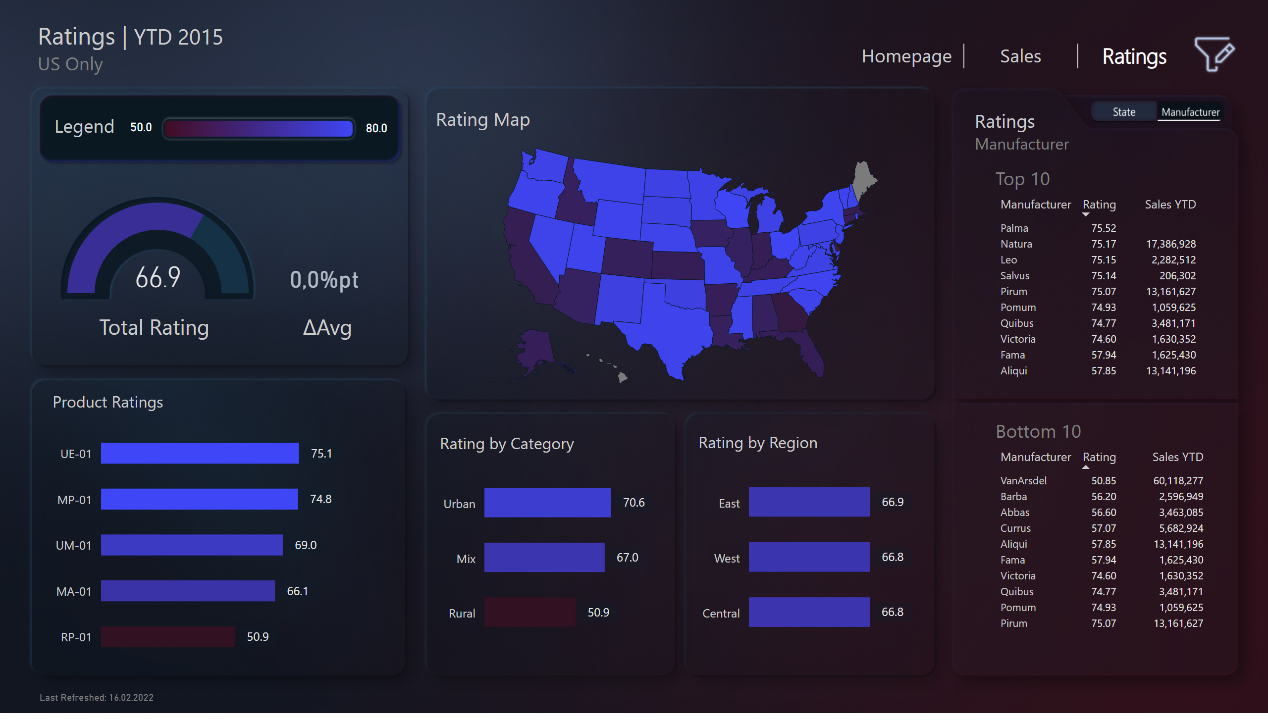
Ratings
Notes:
card
No alt text provided
textbox
No alt text provided
pivotTable
No alt text provided
pivotTable
No alt text provided
clusteredBarChart
No alt text provided
textbox
No alt text provided
Top 10
No alt text provided
Bottom 10
No alt text provided
actionButton
No alt text provided
actionButton
No alt text provided
Rating Map
No alt text provided
Rating by Category
No alt text provided
Rating by Region
No alt text provided
Product Ratings
No alt text provided
textbox
No alt text provided
card
No alt text provided
card
No alt text provided
gauge
No alt text provided
textbox
No alt text provided
textbox
No alt text provided
card
No alt text provided
image
No alt text provided
textbox
No alt text provided
Button active default
No alt text provided
Button default
No alt text provided
actionButton
No alt text provided
actionButton
No alt text provided
actionButton
No alt text provided
shape
No alt text provided
shape
No alt text provided

